Slide 1
Object Oriented Programming in Java Week 6

Slide 2
Today
Reviews
Encapsulation
Static
Final
Relationships among classes

Slide 3
Constructor Calls in hierarchy
In a class hierarchy, subclass constructor must invoke a super class constructor
Default constructor of super class is invoked automatically when no other super constructor is invoked
If no default constructor exists in super class, a non-default constructor must be invoked explicitly
Default constructor in a subclass:
Default constructor is created when there is no constructor in the class
But , it should be able invoke a default constructor of the super class
If there is no default constructor in the super class,
then default constructor cannot be automatically generated for the subclass
some constructor(s) must be defined explicitly for the sub class, and these constructors must invoke an appropriate super constructor
class A { A(int i) {} }
class B extends A { B() { super(5); } }

Slide 4
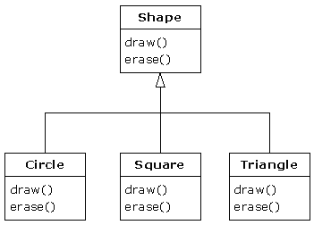
Declared Type vs Actual Type
Declared type:
The type the variable is declared with
Indicates what methods can be invoked
Only methods defined in the declared type can be invoked on an object
Actual type:
The type of which the object is created with the constructor call
Actual type determines run-time binding of method invocations
Shape s;
s = new Circle();
s.draw();

Slide 5
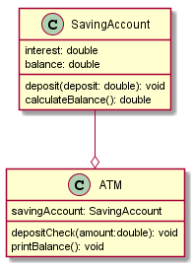
Encapsulation
public class SavingAccount {
double interest = 0.03, balance;
void deposit(double deposit) {
balance += deposit;
}
double calculateBalance() {
//some interest-calculations
return balance;
}
}
public class ATM {
SavingAccount savingAccount;
void depositCheck(double amount) {
savingAccount.deposit(amount);
}
void printBalance() {
System.out.println(savingAccount.balance);
}}
savingAccount.interest = 0.05;
savingAccount.balance *= savingAccount.interest;

Slide 6

Encapsulation
public class SavingAccount {
private double interest = 0.03, balance;
void deposit(double deposit) {
balance += deposit;
}
double calculateBalance() {
//some interest-calculations
return balance;
}
}
public class ATM {
SavingAccount savingAccount;
void depositCheck(double amount) {
savingAccount.deposit(amount);
}
void printBalance() {
System.out.println(savingAccount.calculateBalance());
}}
savingAccount.interest = 0.05;
savingAccount.balance *= savingAccount.interest;

Slide 7
Encapsulation
Protect an object’s internal state
Reduce dependencies among class
In general, use the narrowest access possible

Slide 8
Access Modifiers for members, methods
Specifier | class | subclass | package | world
private | X
protected | X | X | X
public | X | X | X | X
package | X |  | X
See http://java.sun.com/docs/books/tutorial/java/javaOO/accesscontrol.html

Slide 9
Access Modifiers for classes
Public
Friendly/package
Inner classes are different – we will study them later

Slide 10
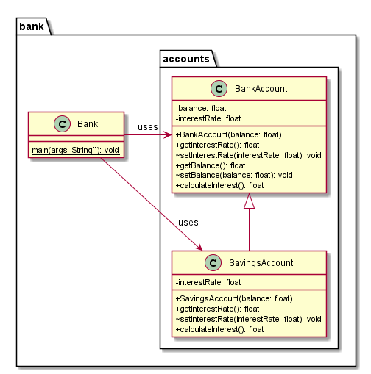
Encapsulation across Inheritance
public class BankAccount {
private float interestRate, balance;
public BankAccount(float balance) {
this.balance = balance;
interestRate = 0.03f;
}
public float getInterestRate() {
return interestRate;
}
void setInterestRate(float interestRate) {
this.interestRate = interestRate;
}
public float getBalance() {
return balance;
}
void setBalance(float balance) {
this.balance = balance;
}
public float calculateInterest() {
return interestRate * balance;
}
}

Slide 11
Encapsulation across Inheritance
public class SavingsAccount extends BankAccount {
private float interestRate;
public SavingsAccount(float balance) {
super(balance);
interestRate = 0.04f;
}
@Override
public float getInterestRate() {
return interestRate;
}
@Override
void setInterestRate(float interestRate) {
this.interestRate = interestRate;
}
@Override
public float calculateInterest() {
return interestRate * getBalance();
}
}

Slide 12
Encapsulation across Inheritance
import bank.accounts.BankAccount;
import bank.accounts.SavingsAccount;
public class Bank {
public static void main(String[] args) {
BankAccount bankAccount = new BankAccount(100);
SavingsAccount savingsAccount = new SavingsAccount(100);
System.out.println(bankAccount.calculateInterest());
System.out.println(savingsAccount.calculateInterest());
}
}

Slide 13
Static variables
public class BankAccount {
static float transactionFee = 0.2f;
}
public class SavingsAccount extends BankAccount {
static float transactionFee = 0.4f;
}
public class Bank {
public static void main(String[] args) {
BankAccount bankAccount = new BankAccount();
SavingsAccount savingsAccount = new SavingsAccount();
System.out.println("BankAccount fee: " + BankAccount.transactionFee);
System.out.println("SavingsAccount fee: " + SavingsAccount.transactionFee);
savingsAccount.transactionFee = 0.3f; //using object to change class variable
System.out.println("SavingsAccount fee: " + SavingsAccount.transactionFee);
}
}
Compiler will give warning if static variable is accessed via an object
What if SavingsAccount does not have its own transactionFee?
Cannot have static local variables, unlike C/C++: Only final is allowed for local variables

Slide 14
Final
Final variable: constant
Member or local variable
Final method: cannot be over-ridden
Final class: cannot be sub-classed
public class Circle {
public static final double PI = 3.14159;
public final double calculateArea(double radius) {
return PI * radius * radius;
}
public static void main(String[] args) {
Circle c = new Circle();
System.out.println("Area = " + c.calculateArea(5));
}
}

Slide 15
Local variables
Local variables are not initialized by default
You need to initialize them before using
void someMethod() {
int i;
System.out.println(i);
}

Slide 16
Relationships among Classes
Common relationships between two classes:
Inheritance: is-a relation
Composition/Aggregation: has-a relation
Dependence/Association: uses-a relation
Notes:
In the has-a relation, objects of class A contains objects of class B. In many situations, objects of class B come into existence with the creation of objects of A and they disappear when objects of class A disappear. Sometimes, objects of class A manages the lifetime of objects of class B, that is, objects of class A creates objects of class B, use them and dispose them. Note that, however, in Java, object disposal is not an explicit operation.
Your new class can be made up of any number and type of other objects, in any combination that you need to achieve the functionality desired in your new class. Because you are composing a new class from existing classes, this concept is called composition. Composition is often referred to as a “has-a” relationship, as in “a car has an engine.”
Composition comes with a great deal of flexibility. The member objects of your new class are typically private, making them inaccessible to the client programmers who are using the class. This allows you to change those members without disturbing existing client code. You can also change the member objects at run time, to dynamically change the behavior of your program. Inheritance does not have this flexibility since the compiler must place compile-time restrictions on classes created with inheritance, as we shall see later.
In the uses-a relation, an object of class A has a reference to an object of class B. Object of class A doesn’t create object of class B. Rather, object of class B may exist without an object of class A. Most of the time, when an object of class A is being constructed, the reference to object of class B is passed to the constructor of object A. Also, it is common that a reference to object B is attached to the object A via a setter method.
From Core Java
“A simple rule can help you decide whether or not inheritance is the right design for your data. The “is–a” rule states that every object of the subclass is an object of the superclass. For example, every manager is an employee. Thus, it makes sense for the Manager class to be a subclass of the Employee class. Naturally, the opposite is not true—not every employee is a manager.
Another way of formulating the “is–a” rule is the substitution principle. That principle states that you can use a subclass object whenever the program expects a superclass object.”

Slide 17
code
public class Order {
private ArrayList<OrderItem> orderItems; // a collection of order items
public void addOrderItem(OrderItem item) { // may not be desired
// implement
}
public void addOrderItem(String upc, int quantity, double price) // implement
public void removeOrderItem(String upc, int quantity) // implement
public void printOrderItems() // implement
public double getTotal() {
double total = 0;
for (OrderItem item : orderItems) {
total += item.getCost();
}
return total;
}
public boolean pay(Account account) // logic to pay using account
}
public class OrderItem {
private String upc;
private int quantity;
private double price;
// constructors, getter/setters etc
public double getCost() {
return quantity * price;
}
}

Slide 18
code
public class RushOrder extends Order {
private int deliveryDay;
public RushOrder(int d) {
super();
deliveryDay = d;
}
@Override
public double getTotal() {
double total = super.getTotal();
if (total == 0) {
return total;
}
// add delivery charge to total based on deliveryDay
return total;
}
}

Slide 19
Dynamic programming (Memoization) for Recursion
Fibonacci Numbers
F(n) = F(n-1) + F(n-2)
F(0) = 0
F(1) = 1
Memoization
Cache the calculated numbers as opposed to calculating them again
E.g.
F[6] = F[5] + F[4]
F[5] = F[4] + F[3]

Slide 20
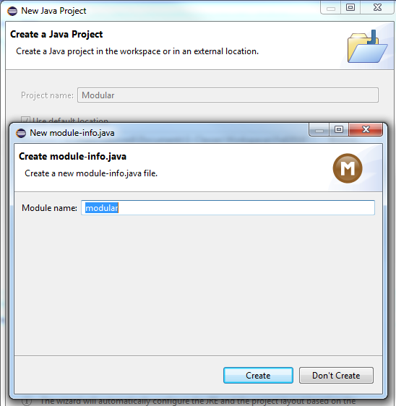
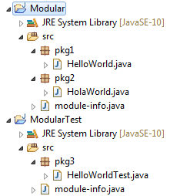
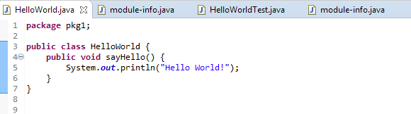
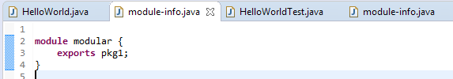
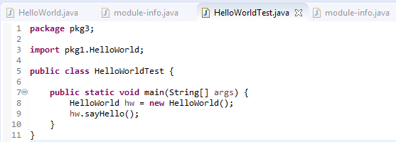
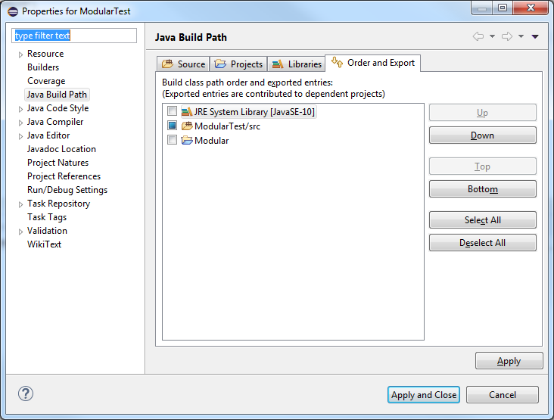

Appendix: Java Module
A group of closely related packages and resources along with a new module descriptor file.
A good resource to learn more about packages: https://www.youtube.com/watch?v=rfOjch4p0Po
Notes:
Note you can have nested packages.

